Slide 1

PROJECT MANAGEMENT

Slide 2






Team Members
Adi Lakshmi
Ramadevi
Naveen Kumar
Vineetha
Vinesh Reddy
Akhila

Slide 3

AGENDA
Introduction
Importance of Project Management
Project Management Plan
Project Management Methodologies
Project Management Knowledge Areas
Phases of Project Management
Project Management Reports
Project Management Tools
JIRA
CONCLUSION
Akhila

Slide 4
Introduction
Project management provides a structured approach to guide and control the project throughout its lifecycle, ensuring that it meets its goals while considering constraints such as time, budget, scope, and quality.
Akhila

Slide 5
Importance of Project Management
Scope and Time Management
Resource Optimization
Collaboration and Communication
Risk Mitigation
Stakeholder Engagement
Quality Assurance
Akhila

Slide 6

Project Management Plan
Project Overview
Project Scope
Project Schedule
Project Resources
Project Budget
Communication Plan
Akhila

Slide 7
Project Management knowledge Areas
Integration Management
Scope Management
Schedule Management
Cost Management
Quality Management
Resource Management
Communications Management
Risk Management
Procurement Management
Stakeholder Management
Vineetha

Slide 8
Project Management Methodologies
Waterfall methodology
Agile methodology
Scrum methodology
Kanban methodology
Scrumban methodology
eXtreme programming (XP) methodology
Adaptive project framework
Lean methodology
Naveen Kumar

Slide 9
Phases of Project Management
Initiation
Planning
Execution
Monitoring and control
Closure
Naveen Kumar

Slide 10
Project Management Reports
Project Status Report
Financial Report
Progress Report
Risk Assessment Report
Quality Assurance Report
Executive Summary Report
Technical Report
Ramadevi

Slide 11
Project Management Tools
Bugzilla
ALM
JIRA
Tracker
Intent+
QC
Ramadevi

Slide 12
JIRA
History of JIRA
Features of JIRA
JIRA Test Management
JIRA Workflow
Dash Boards in JIRA
Integration with Other Tools
Adi Lakshmi

Slide 13
JIRA
JIRA is a project management tool that helps teams to plan, track, and manage their work effectively. It was developed by Atlassian and is widely used in software development companies.
Adi Lakshmi

Slide 14
History of JIRA
JIRA is a tool developed by Australian Company Atlassian. It is used for bug tracking, issue tracking, and project management. The name JIRA is actually inherited from the Japanese word Gojira which means Godzilla.
Track issue and bugs related to your software and mobile apps. It is also used for project management.
Adi Lakshmi

Slide 15
Features of JIRA
Issue Tracking
Agile Project Management
Workflow Management
Collaboration and Communication
Reporting and Analytics
Field Configuration
Notifications
Permissions Stories Tracking
Adi Lakshmi

Slide 16
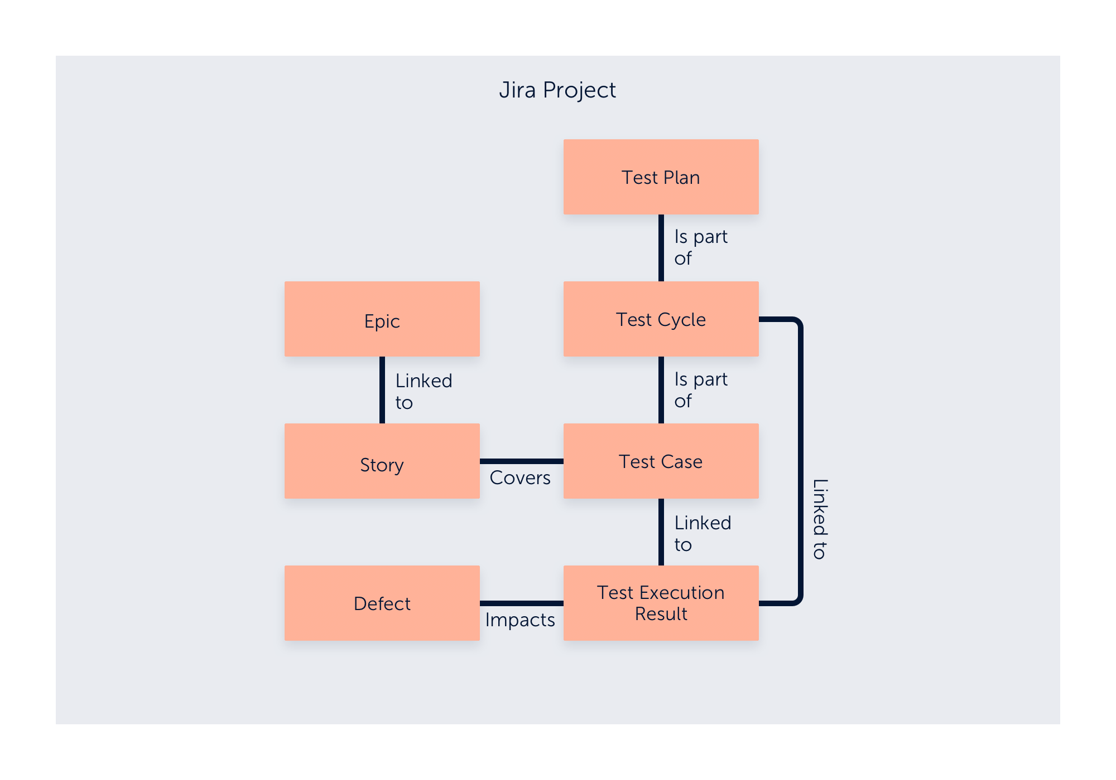
JIRA Test Management
Adi Lakshmi

Slide 17
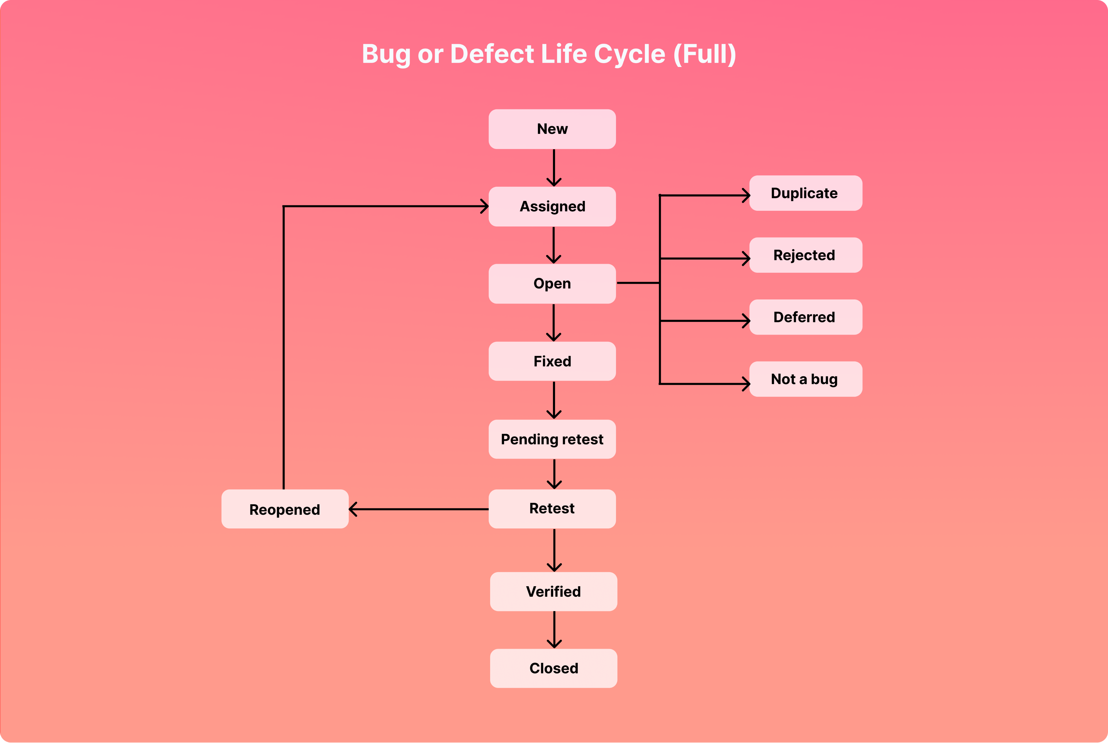
JIRA Workflow
Adi Lakshmi

Slide 18
Dash Boards in JIRA
Project Overview Dashboard
Agile Scrum Dashboard
Kanban Dashboard
Issue Tracking Dashboard
Release Management Dashboard
Portfolio Dashboard
Vinesh Reddy

Slide 19
Integration With Other Tools
JIRA can be integrated with other tools like
Confluence
Bitbucket
Qmetry
zephyr
Slack
Vinesh Reddy

Slide 20
CONCLUSION
Throughout the project lifecycle, project managers lead teams, develop comprehensive project plans, execute tasks, monitor progress, manage risks, and communicate with stakeholders.
They apply various methodologies and tools to optimize project outcomes and adapt to changing circumstances.
Vinesh Reddy

Slide 21
Have Any Queries?
Adi Lakshmi
Ramadevi
Naveen Kumar
Vineetha
Vinesh Reddy
Akhila

Slide 22


